Slide 1

Knowbot: A DL-Powered Chatbot for Conversational Assistance

Slide 2
About Knowbot
The Knowbot chatbot is an advanced conversational AI designed to engage with users in a human-like manner. It uses state-of-the-art deep learning technology to provide quick and relevant responses to user inputs, thereby improving the overall user experience. The purpose of Knowbot is to facilitate communication and provide assistance to users, especially students and faculty in colleges. By integrating with the college systems, it'll be possible to deliver fast and efficient support at any time, enabling users to quickly get the information they need and carry out tasks effectively. With Knowbot, users can rest assured that they're getting personalized and accurate assistance whenever they need it.

Slide 3

Conversational Interface
The conversational interface of Knowbot is designed to mimic human-like conversations. It uses natural language processing (NLP) and machine learning algorithms to understand user inputs and provide relevant responses. The chatbot is integrated with college systems, which allows it to offer assistance or information in a conversational manner.

Slide 4


Integration with College Systems
The integration of Knowbot with college systems will allow students to easily access important information and receive assistance in a conversational manner. By integrating with systems such as the student information system and course management system, Knowbot can provide personalized responses to students' inquiries about their academic progress, course schedules, and more.

Slide 5
Objective
Uninterrupted Student Support: Aims to create an educational chatbot accessible round-the-clock, ensuring continuous assistance for students whenever needed.
Reliable and Prompt Responses: Focuses on delivering accurate and quick answers to student queries, promoting efficient comprehension of complex concepts.
Personalized Learning Experiences: Emphasizes adapting to individual students' learning styles, speeds, and methods for a tailored educational journey.
Adaptive Learning: Capable of adjusting content delivery and pacing to suit each student's comprehension and progress, ensuring effective learning.
Quizzes and Revision Support: Provides quizzes and revision materials to reinforce learning, aiding in retention and comprehension of subjects.

Slide 6
Feedback and Misconception Resolution: Offers constructive feedback and addresses common misconceptions to enhance understanding and correct learning paths.
Encouraging Engagement: Encourages student engagement through positive reinforcement, motivating continued learning and participation.
Enhanced Comprehension: Aims to facilitate not only answers but also an improved understanding of subjects, promoting deeper learning and retention.
Student-Centric Design: Designed with the student's learning needs and success in mind, aiming to enhance the overall educational experience.
Subject-Specific Expertise: Offers specialized knowledge and expertise in various subjects, catering to a wide range of academic disciplines.
Progress Tracking: Monitors and tracks student progress, providing insights into areas of improvement and mastery.
Real-time Assistance: Offers immediate help during lectures or study sessions, aiding in comprehension and clarification of immediate doubts.

Slide 7
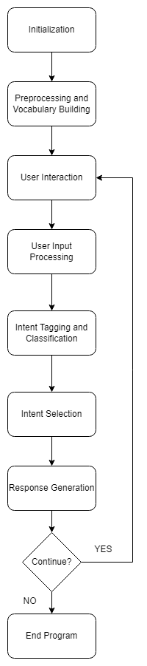
Project Workflow

Slide 8
THANK YOU BY: ISHITA-102183016 EKNOOR KAUR WALIA-102183010 GURPREET KAUR-102183013

